Slide 1
Trackers and Gain Corrections Sam Grant g-2 Collaboration Meeting (Elba): Early Career Session 28th May 2019

Slide 2
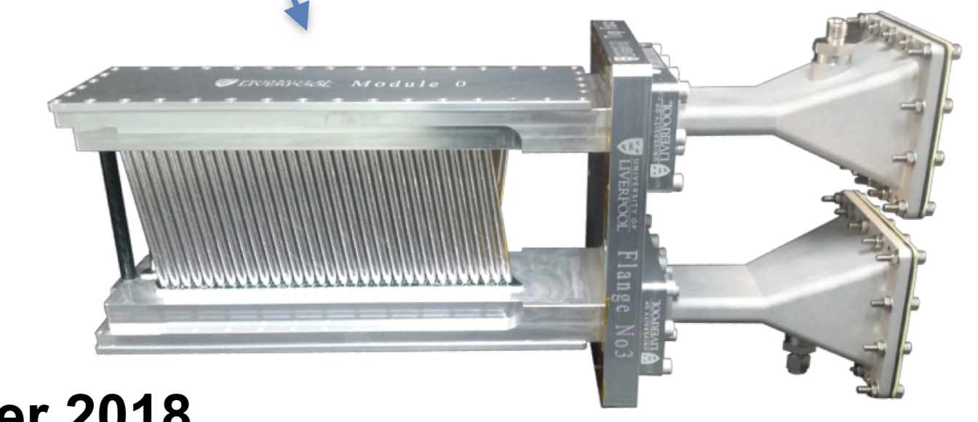
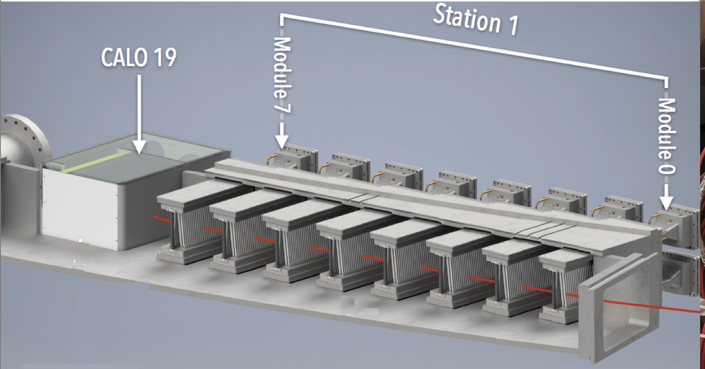
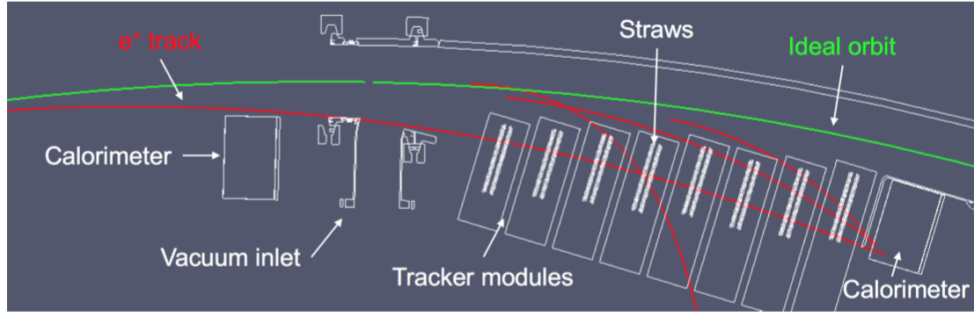
Trackers!
Layers of wire under high voltage, encased in straws filled with an argon-ethane gas mix
Provides information about track momentum and position
Two sets of 8 modules, in front of calorimeters 13 and 19.
Very useful for studying systematics as well!
Ionisation -> Charges drift to wires -> Read out and reconstruct -> No worries

Slide 3
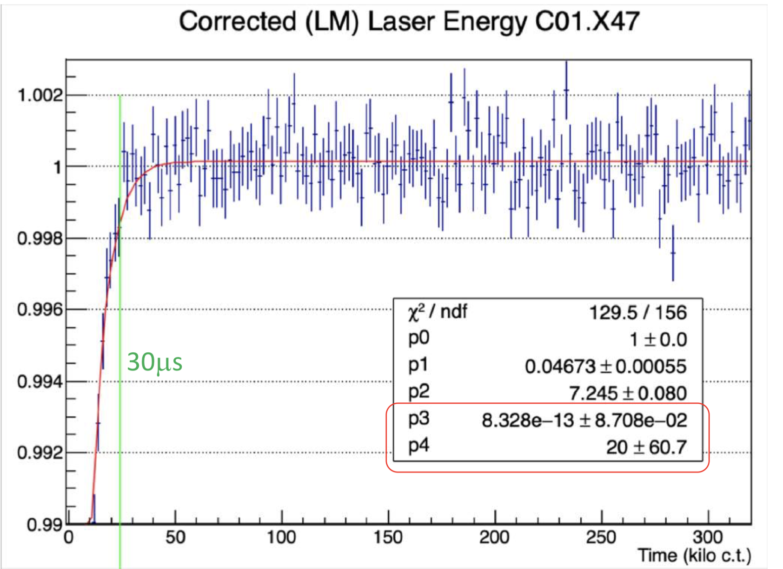
Gain sag!
Sudden drop and subsequent recovery in gain at early times
This is due to bunching after injection saturating the calorimeters
Must be fitted and corrected in processing
Amplitude p₁ and time constant p₂ are used for gain corrections

Slide 4
The E/p ratio
Tracker-calo matched tracks provide a different way to measure gain, so we can perform an independent cross check of the laser.
Gain = measured energy / true energy
E = p, and trackers do not “see” gain sag, so:
Gain = cluster energy (calo) / track momentum (tracker) = E/p

Slide 5
The E/p ratio
Tracker-calo matched tracks provide a different way to measure gain, so we can perform an independent cross check of the laser.
“Just plot E/p vs time for each calo, and fit a function to it to get the amplitude and recovery time”

Slide 6
NOT SO FAST!
🤔

Slide 7
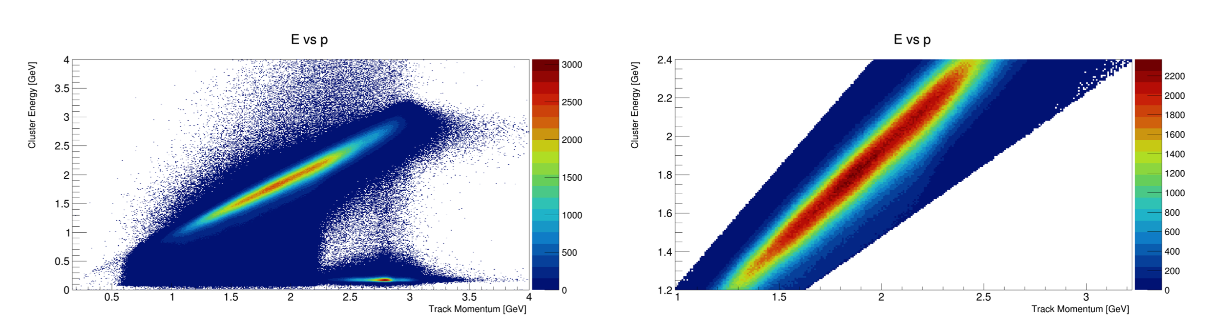
First up, pick a good region in E over p

Slide 8
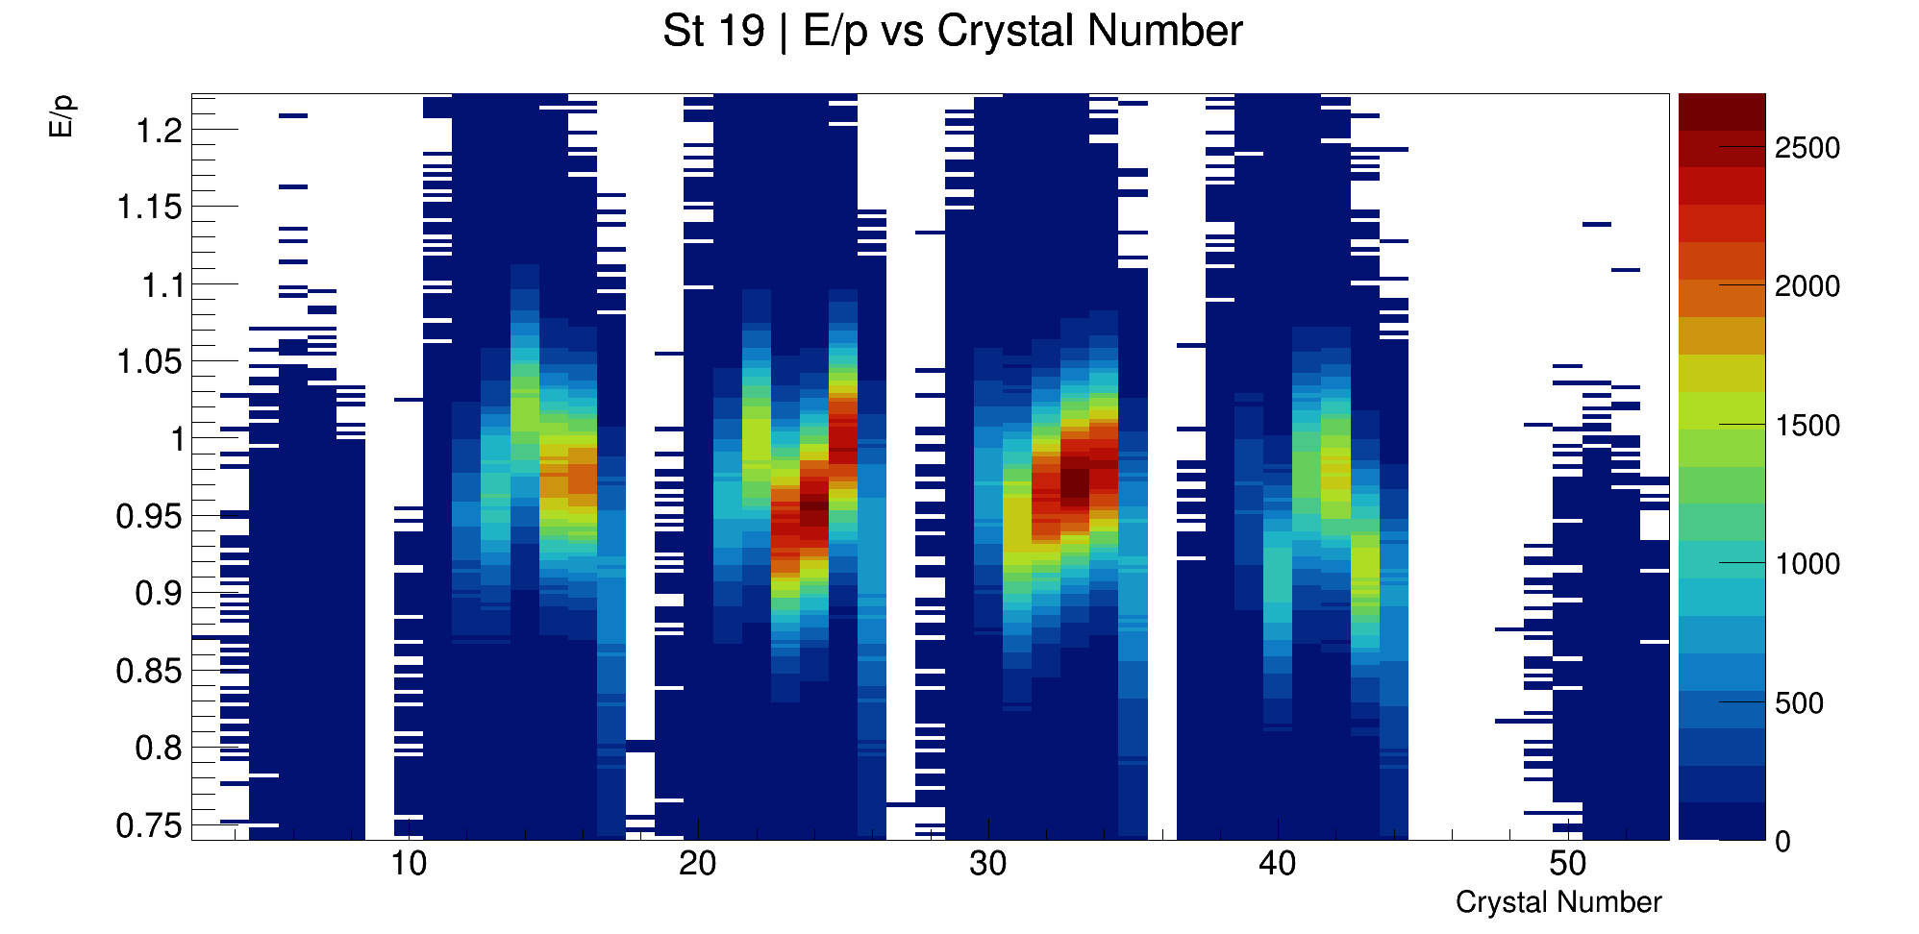
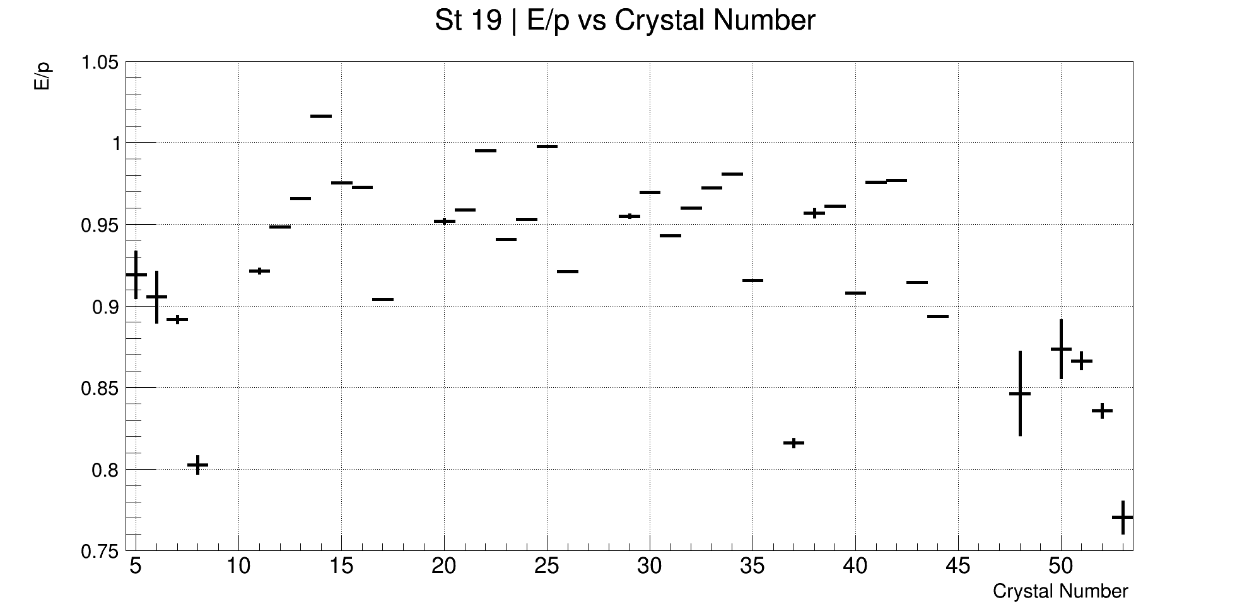
E/p normalisation by crystal
We can mitigate variation in E/p by normalising each crystal to it’s mean E/p (after 60 μs!)
(Gaussian means of each bin)

Slide 9
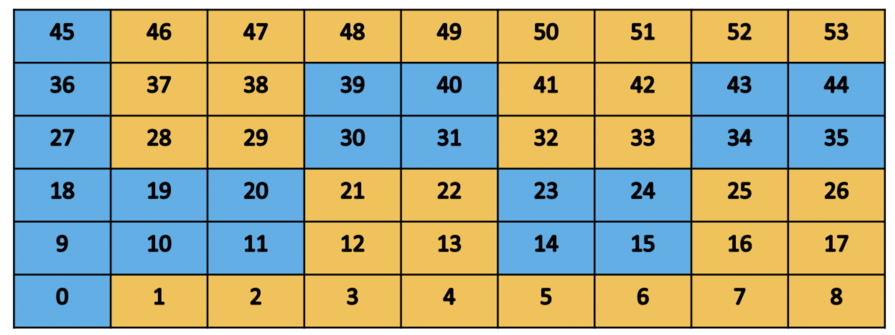
Also, breakout boards
Two different supply circuits – we can’t combine crystals on different boards as they also have different recovery time constants!
Longer lifetime, shorter lifetime

Slide 10
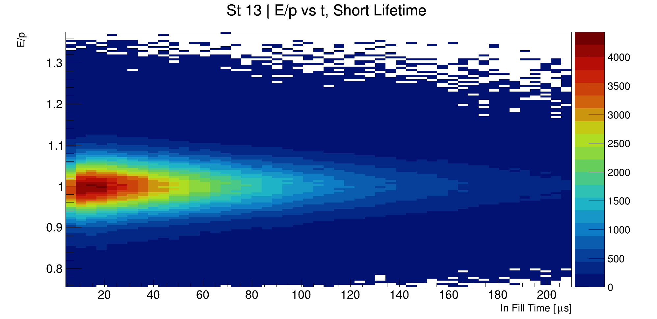
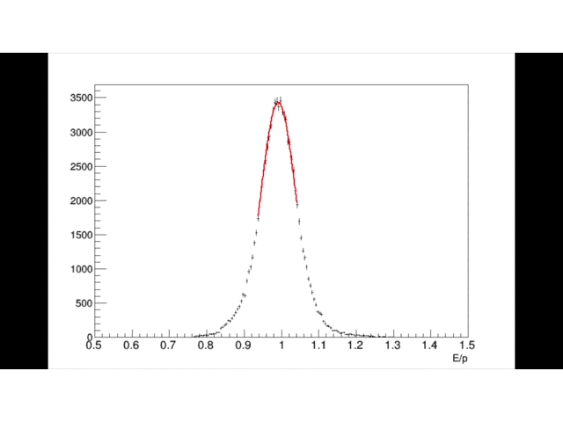
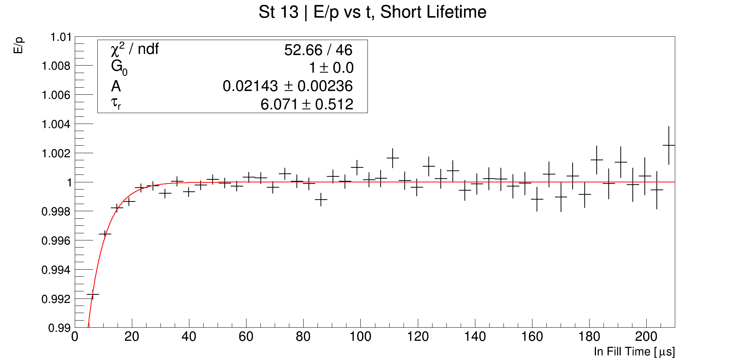
Now we can get some parameters!
1.
2.
Draw normalised 2D plots
Slice vertically and fit the Y projections
Separate boards and draw gaussian means and fit exponential
3.

Slide 11
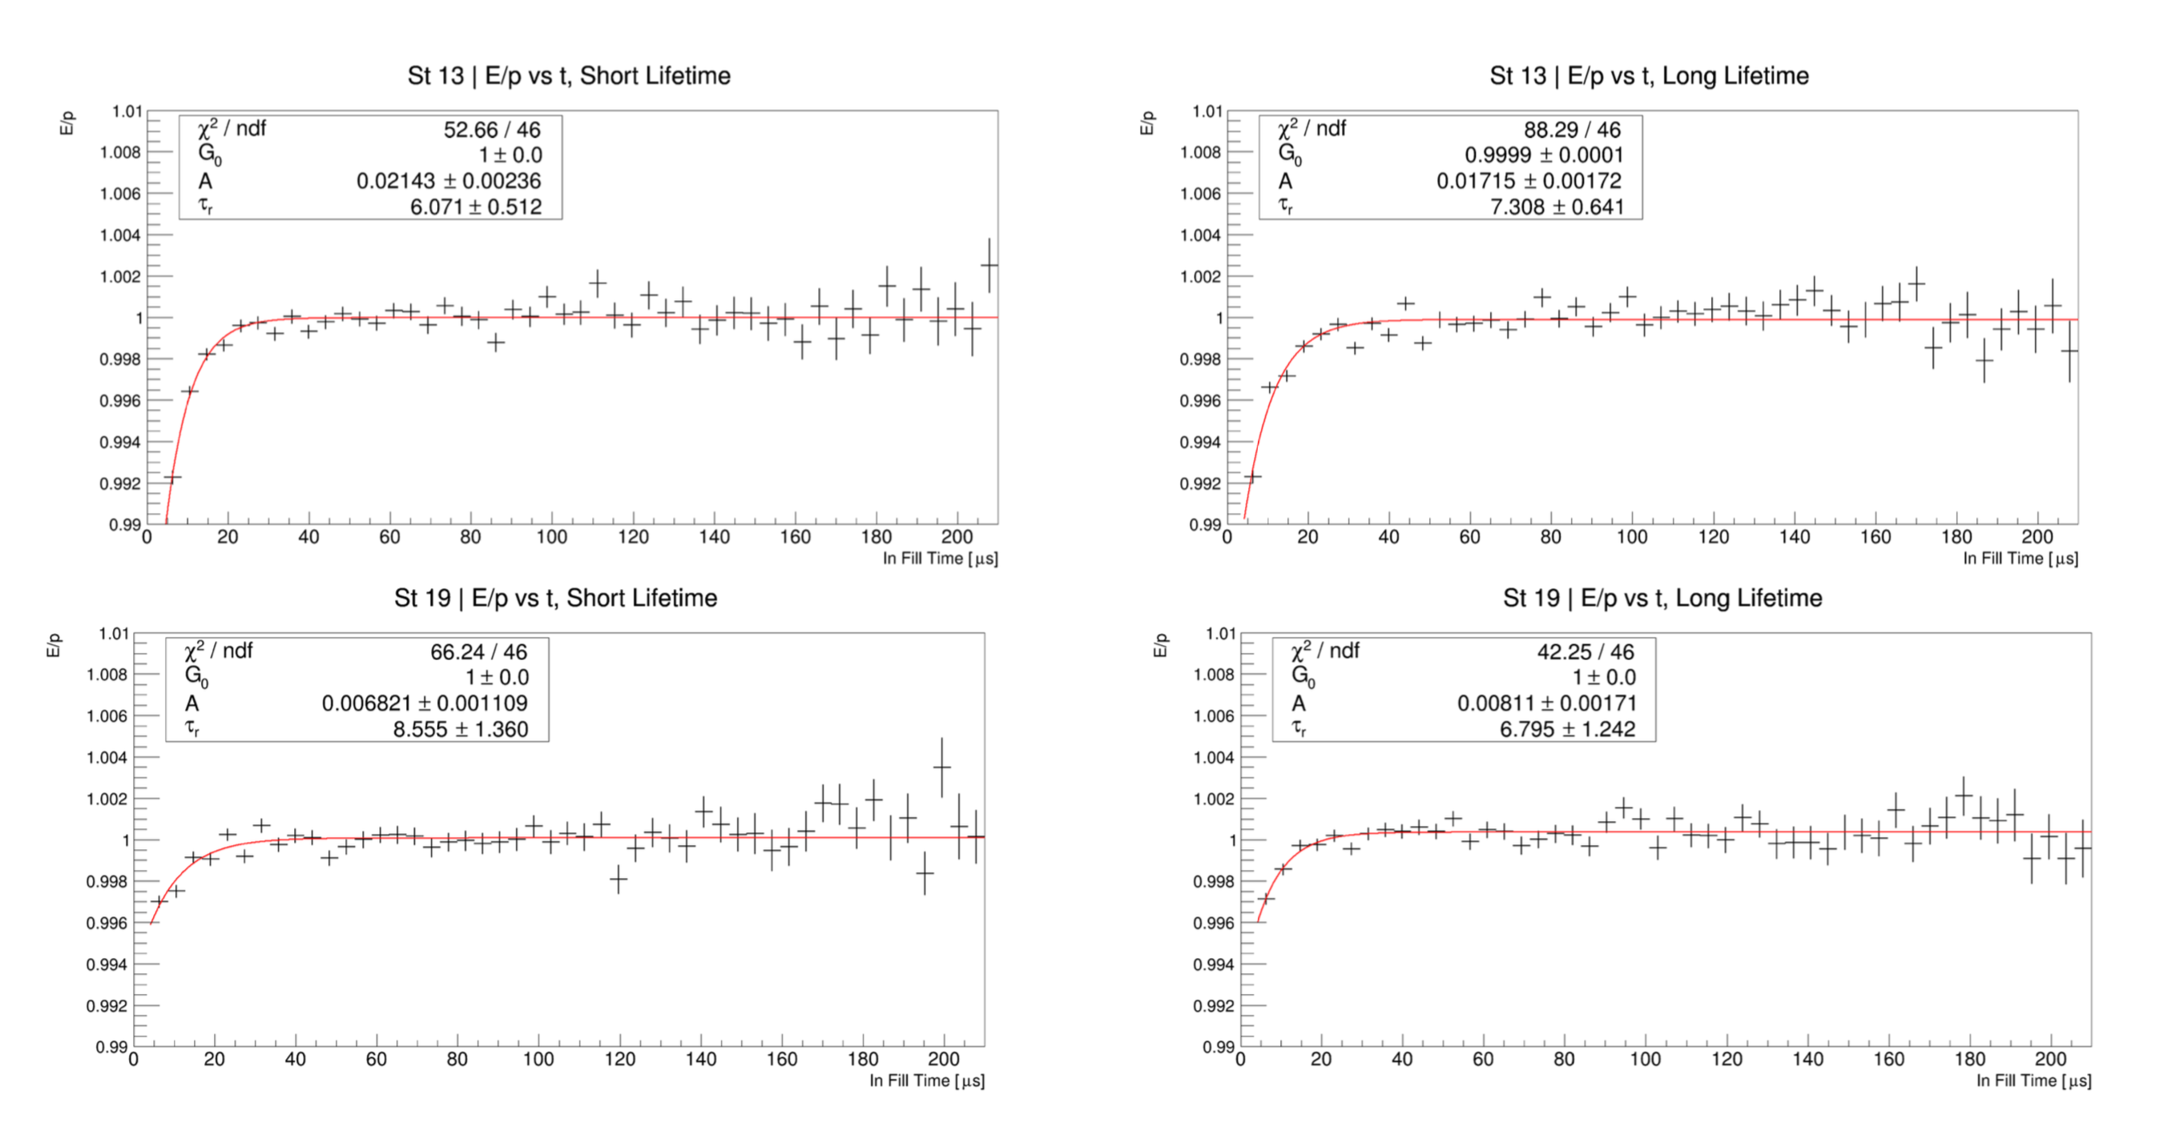
Now we can get some parameters!

Slide 12
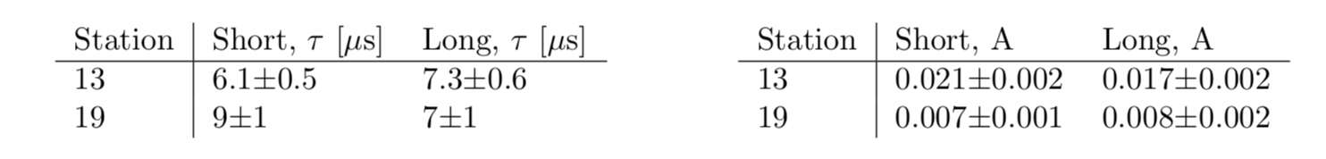
Results, by breakout board
It works for calo 13
Difficulty resolving calo 19, it’s further from injection (so less sensitive to gain sag)

Slide 13
Change tack: crystal by crystal
The laser system records 𝛕 and A for every crystal
I’m limited by stats here, but fitting crystal by crystal allows for a direct comparison

Slide 14
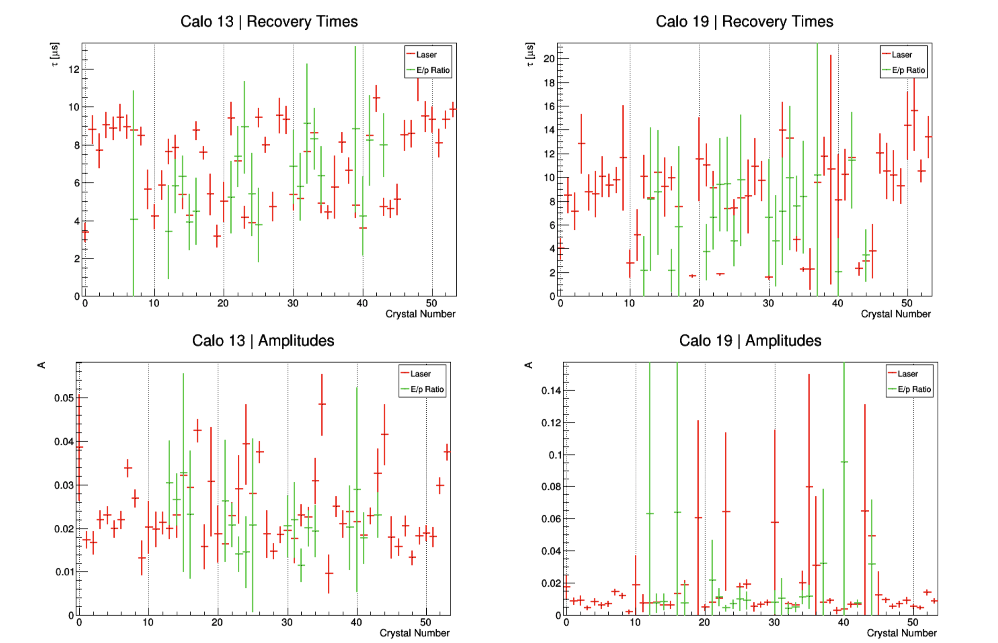
E/p fits crystal by crystal, compared with laser results

Slide 15
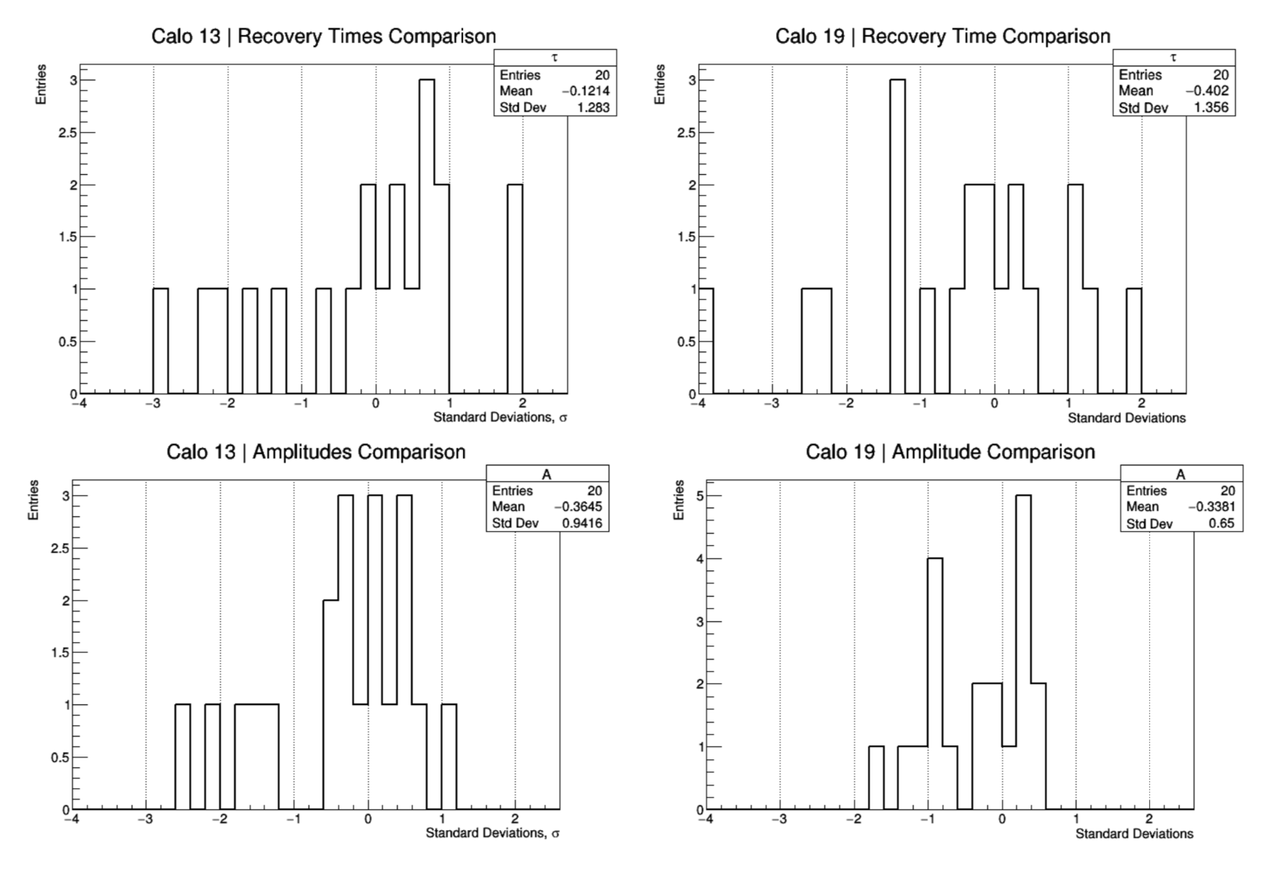
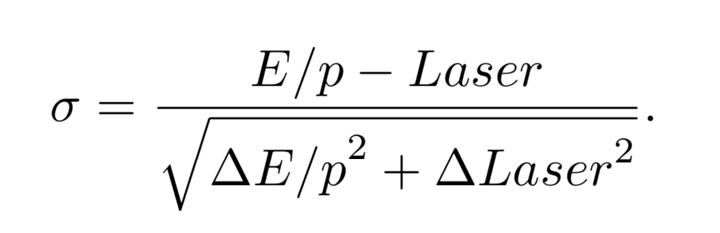
“Pull” of E/p fits and laser results
Vast majority of crystals are within 3 sigma (one exception 🤨)

Slide 16
Gain corrections, summary
Confirmation that gain sag is a real effect and not some quirk of the laser
I claim that the results used for gain corrections, as measured by the laser system, are consistent with mine
Main point: you can trust the corrections applied to remove the gain sag

Slide 17
Thanks!

Slide 18
BACKUP

Slide 19
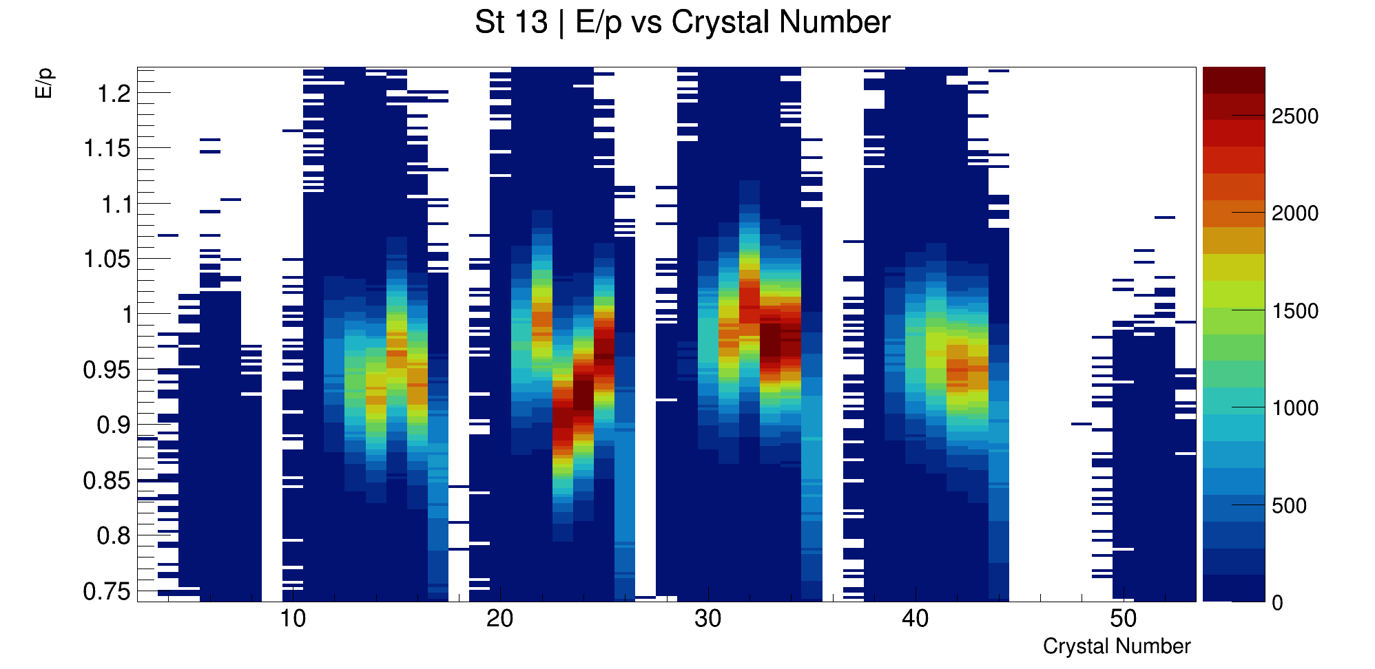
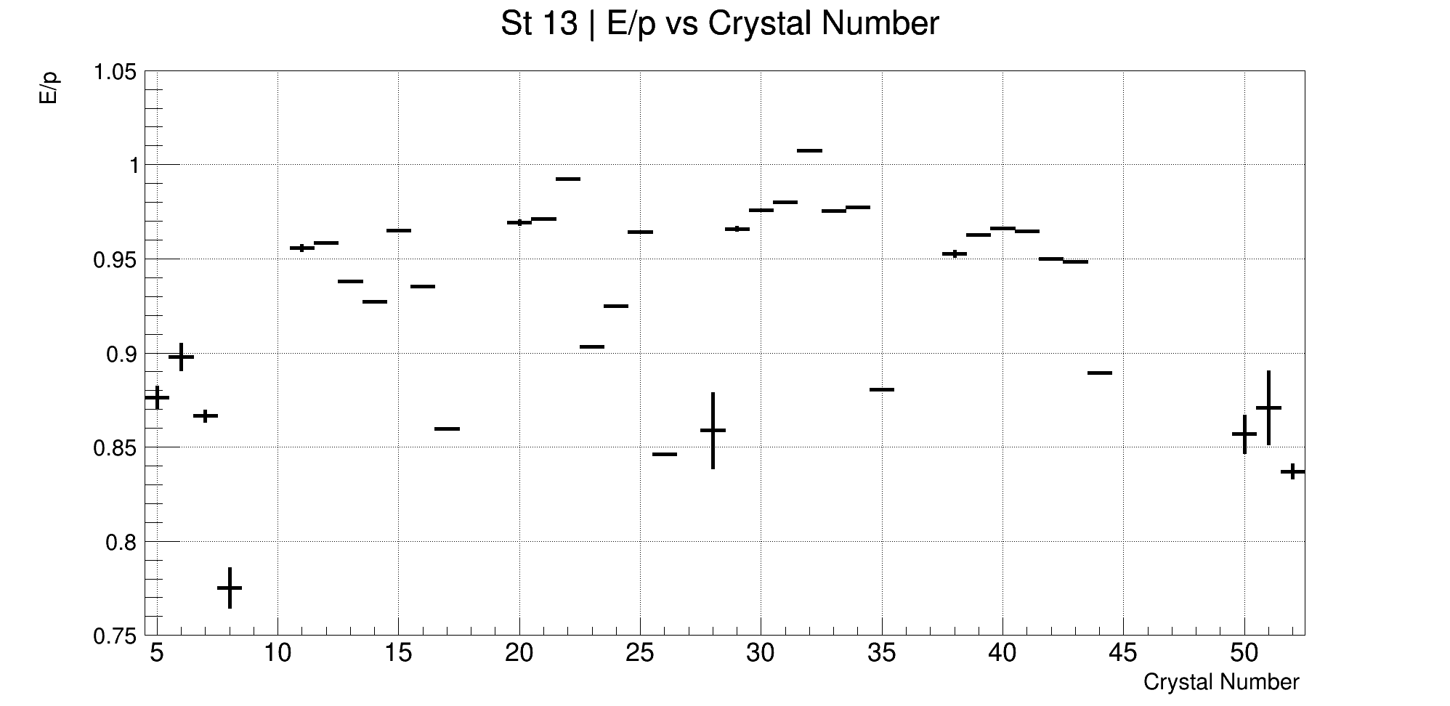
First up, E/p normalisation
We can mitigate variation in E/p by normalising each crystal to it’s mean E/p (after 60 μs!)
(Gaussian means of each bin)

Slide 20
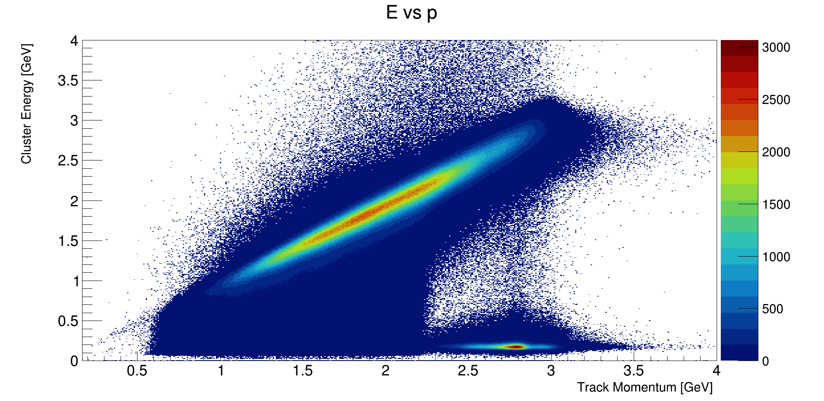
Lost muons!
Where are we?!
μ⁺
μ⁺
μ⁺
μ⁺
Sometimes muons exit the ring due to small perturbations in their orbit
They are a problem if you want to use the trackers: trackers can’t make an energy cut as the calos do

Slide 21
Lost muons!
“How do lost muons affect beam position measurements?”
Where are we?!
μ⁺
μ⁺
μ⁺
μ⁺
Sometimes muons exit the ring due to small perturbations in their orbit
They are a problem if you want to use the trackers: trackers can’t make an energy cut as the calos do

Slide 22
Lost muons, selection
μ⁺
μ⁺
μ⁺
μ⁺
μ⁺
μ⁺
If you know energy AND momentum, you can find your lost muons:
Momentum > 2300 MeV, -3.2 < log(E/p) < -2.4

Slide 23
Lost muons, method
Take tracker only data as “all tracks”
Scale up lost muon population according to the relative efficiency of the calo
Subtract scaled lost muons from ”all tracks”
Have a look at how radial and vertical positions have changed

Slide 24
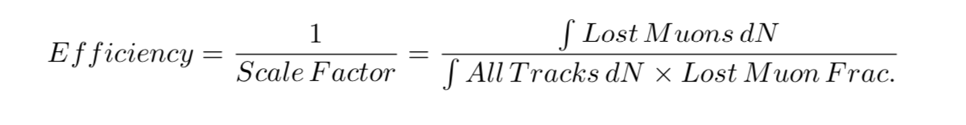
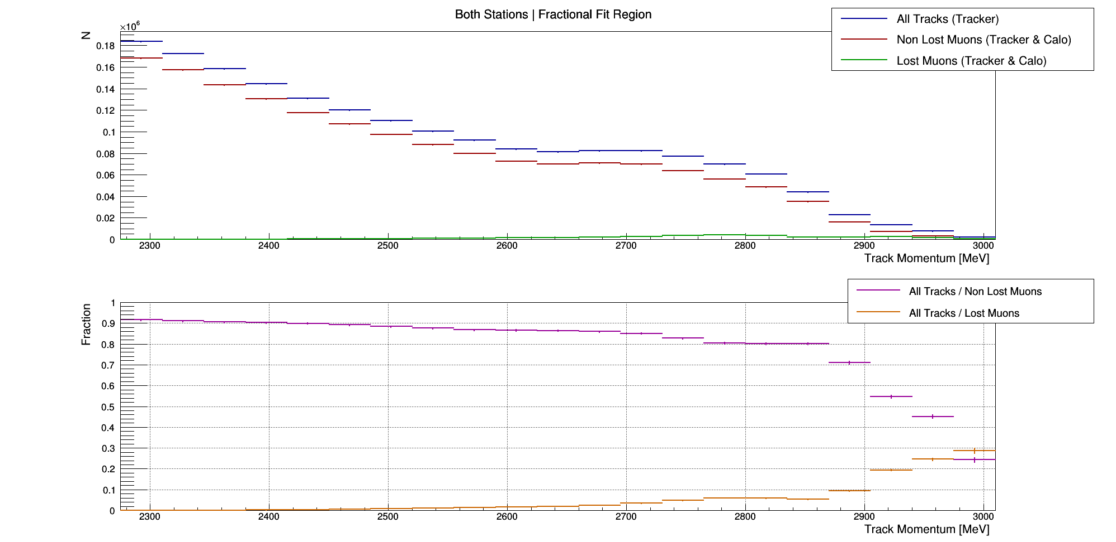
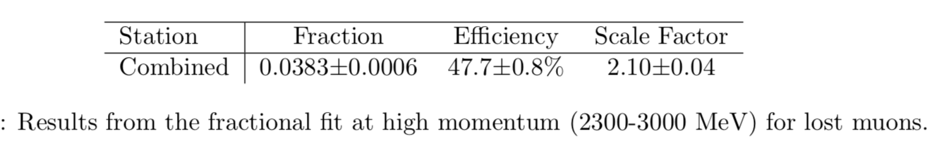
Scaling the lost muons

Slide 25
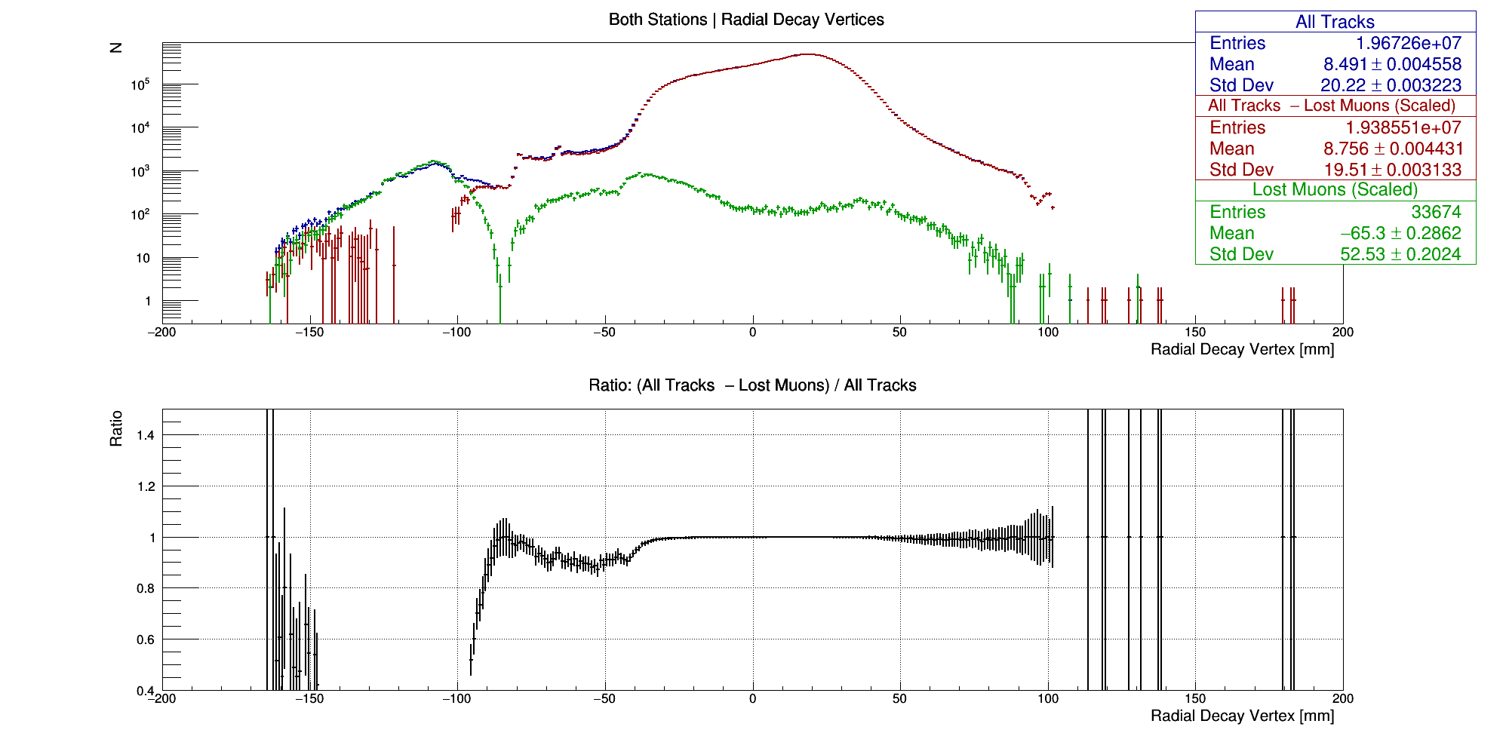
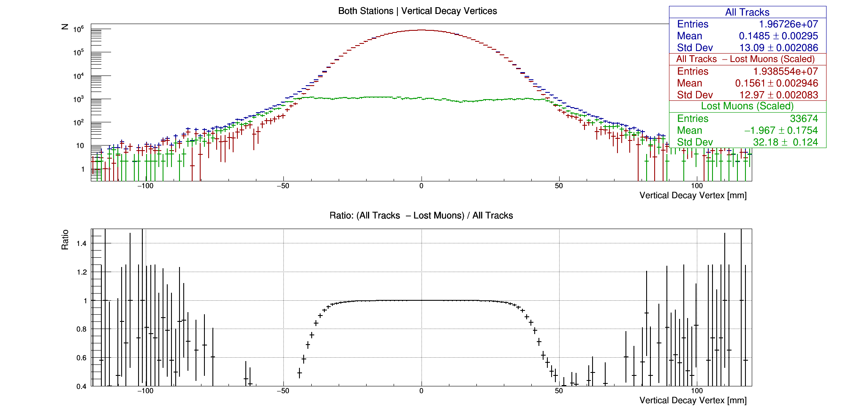
Lost muons!
Interesting tails, let’s cut at +/- 60 mm from the magic radius to get rid of them

Slide 26
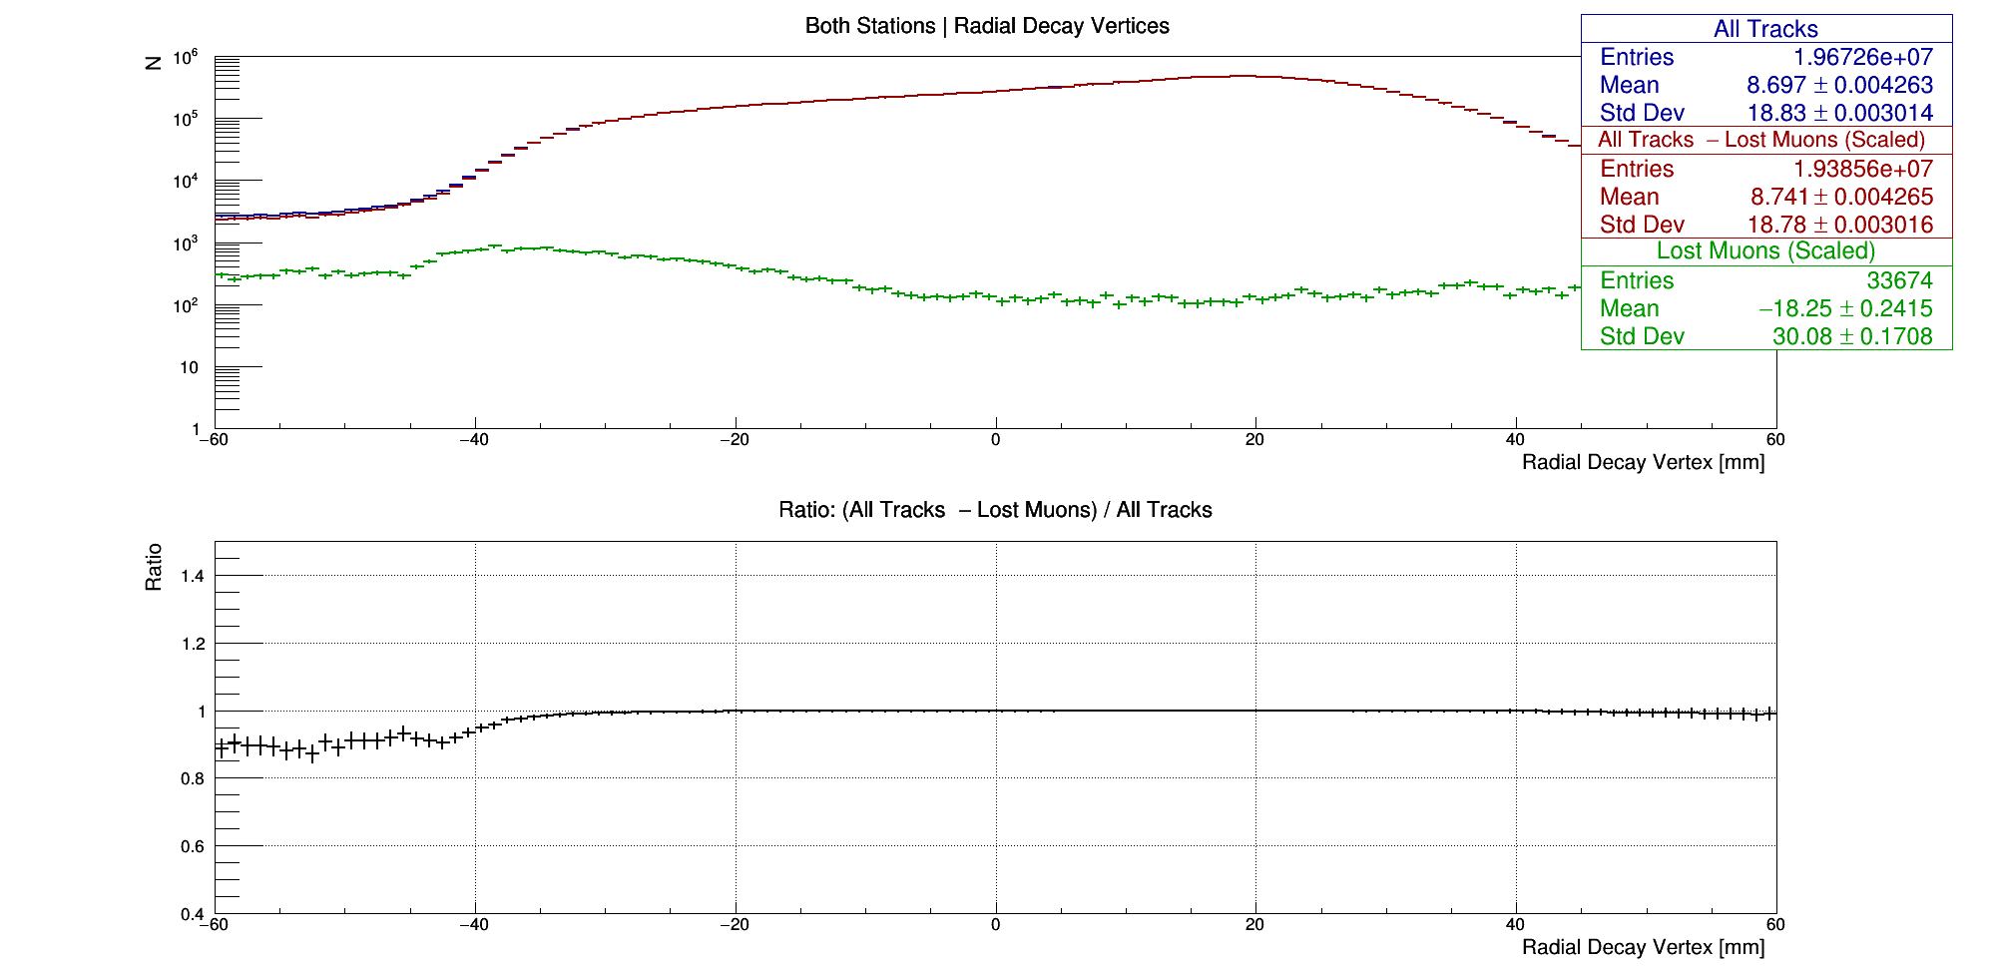
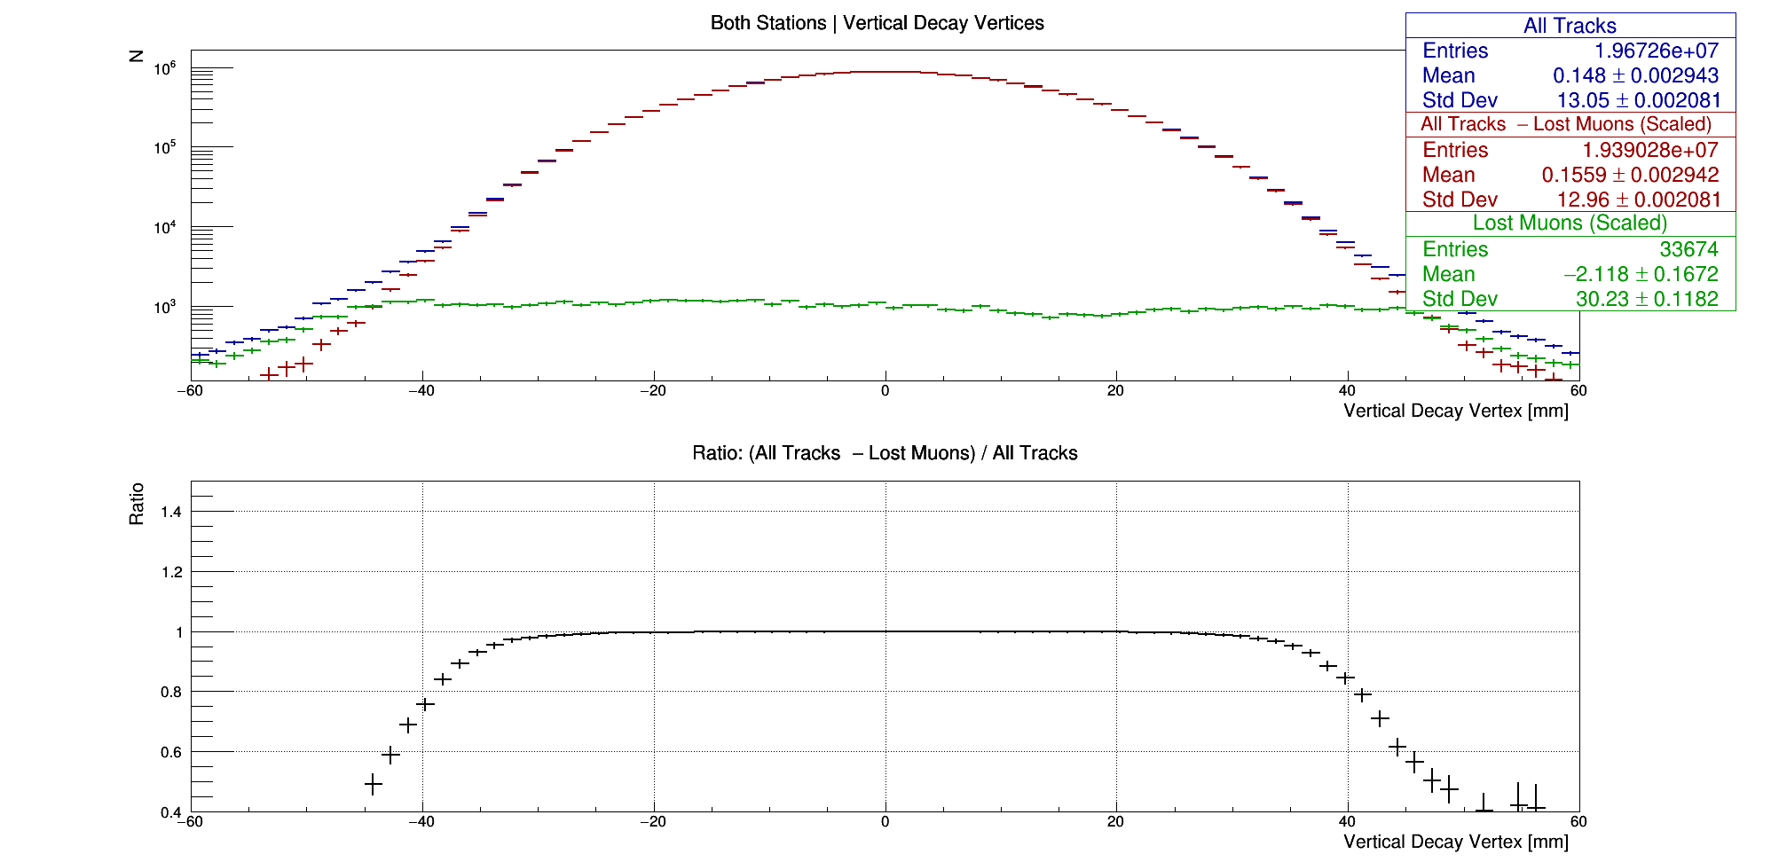
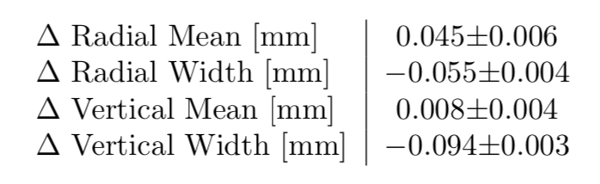
Lost muons, results!

